Slide 1


CCL & Standards Check
WORKSHOP

Slide 2


Housekeeping - Agenda
Fire Exits / Toilets / Mobile Phones / Interaction / Group learning – non judgemental
Start 9:00
Breaks – 10:30 & 14:45 / Lunch 12:15
Finish 16:30
Interactive Course – Your input is essential!
However at times we will need to move on
Agenda – 3 main parts – Lesson Planning / Risk Management / T&L Strats
….

Slide 3
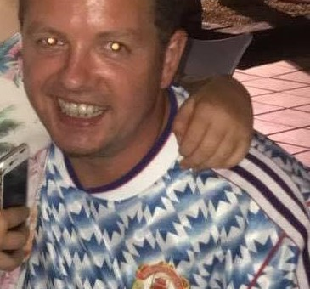
Housekeeping - Agenda
Introduction to SC and research behind the standards
Lesson planning overview
Learning domains and the four competencies
GROW Model and developing safe and responsible drivers – how this helps you on your SC
Risk Management Pass marks & 5 comps
Q’s to manage risk
Core comps
Teaching & Learning Strategies 3 comps and CCL
Learning styles & Scaling model

Slide 4

ICEBREAKER
In Pairs discuss :-
Who you are
Why you are here
What you want to get out of the workshop
Each person has to introduce their partner so be careful to LISTEN!
Non-Judgemental environment – aims to get everybody interacting

Slide 5
THE
PATHWAY
TO CLIENT CENTRED LEARNING
What happened on 7th April 2014
Standards Check replaced Check Test
Where did the Standards Check derive from?
NSDRT (Published 31st October 2011)
What led to the formation of the Standards and the push towards CCL?
30 years of research across Europe (RUE, GADGET,MERIT,HERMES) 3 E’s
Who is familiar with the Goals for Driver Education Matrix
In what year was the G.D.E Matrix formulated
1999 as part of GADGET…From the Theory of Internal Models of Driving Behaviour (1980/1996 Mikkonen & Keskinen)

Slide 6
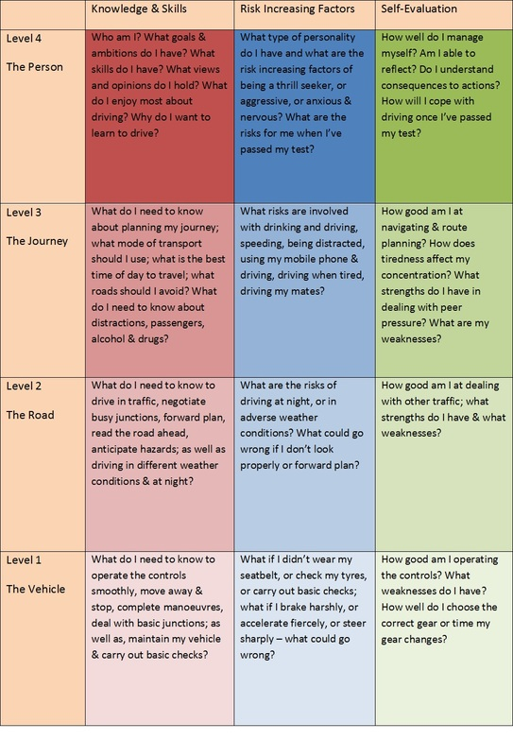
GDE Matrix
(Goals for Driver
Education)

Slide 7
COLLISIONS
Road collisions results in around 1.24 million fatalities
and between 20 to 50 million injuries per year (World Health Organisation April 2022)
Road Traffic Collision investigation reports (Treat et Al 1979; Sabey & Taylor 1980) found that:-
Vehicle/Roadway/Environment were NOT a principle cause of collisions
Driver behaviour a key contributory factor in 90% of collisions (Petridou & Moustaki 2001).
Contributory factors found in GDE higher levels
Core comps – Fault ID / Fault Analysis / Remedy
Left new drivers under-prepared for post-test driving

Slide 8
GDE Matrix
(Goals for Driver
Education)

Slide 9
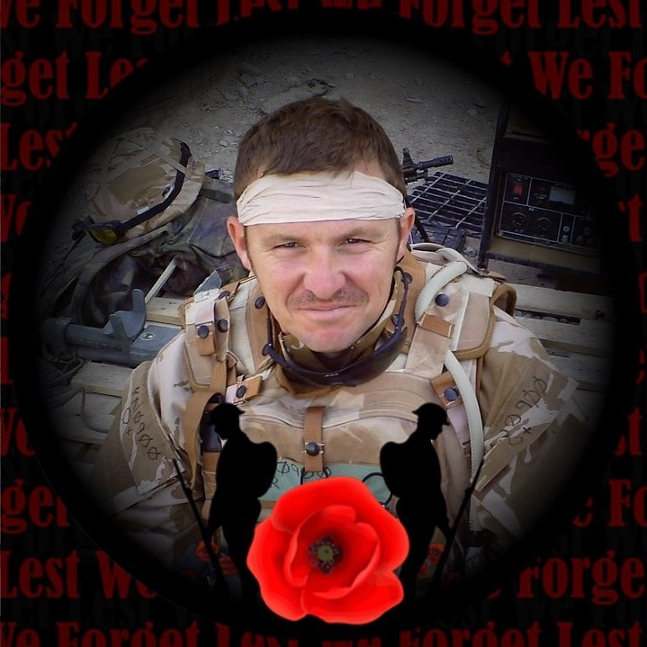
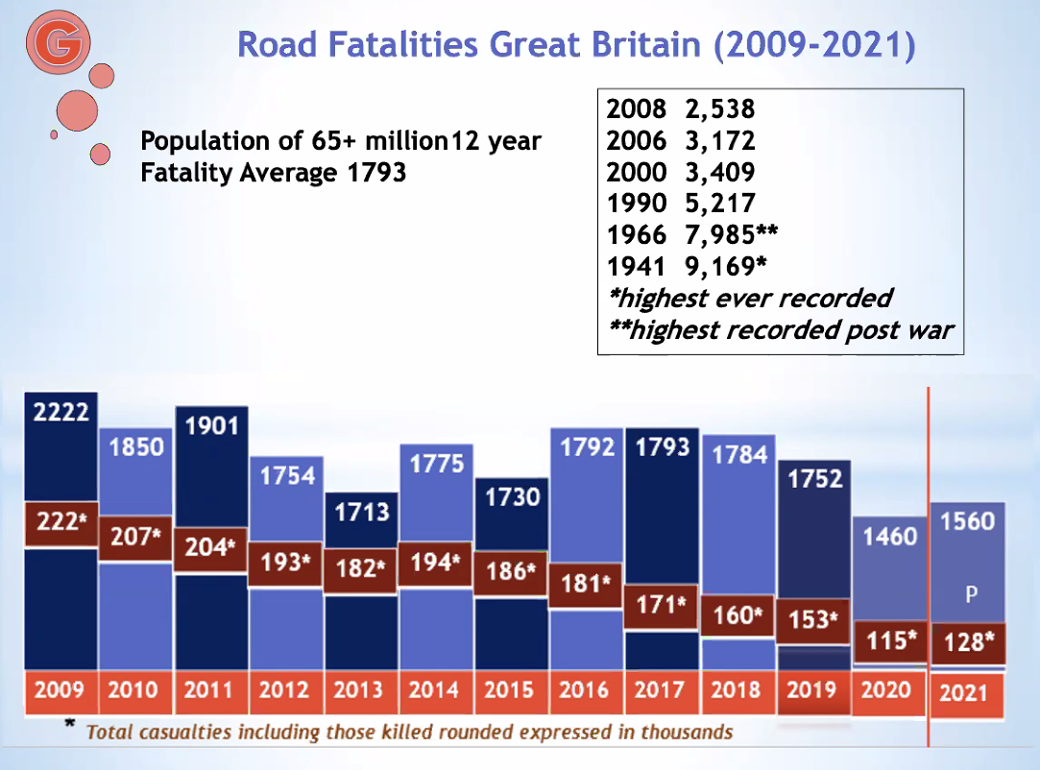
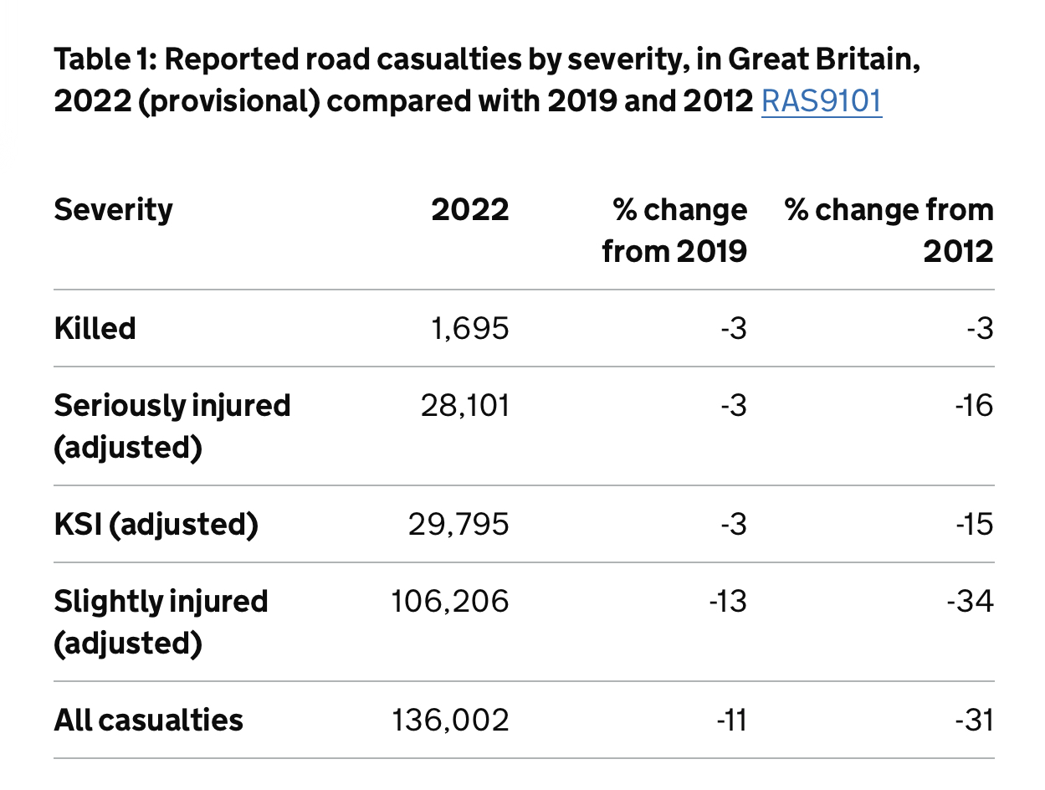
COLLISIONS

Slide 10
LESSON PLANNING
DVSA ADI1:
“The purpose of all driver training is to assess and develop the learner’s skill, knowledge and understanding in relation to the contents of the NSDRT. Research indicates that is best achieved by placing the client at the centre of learning process”
Did the trainer identify the pupils learning goals and needs
Was the lesson structure suited to the pupils experience and current ability
Were the practise areas suitable
Was the lesson plan adapted, when appropriate, to help the pupil work towards their learning goals
PLANNING A LESSON

Slide 11
TOP 5 REASONS ADI’S FAIL STANDARDS CHECKS
DVSA analysis shows the top 5 areas where instructors fail to demonstrate competence are where they haven’t:-
Adapted the lesson plan, when appropriate, to help the pupil work towards their learning goals
Taught the lesson in a style suited to the pupil’s learning style and current ability
Encouraged the pupil to analyse problems and take responsibility for their learning
Given the pupil appropriate and timely feedback during the session
Given enough feedback to help the pupil understand any potentially safety-critical incidents

Slide 12
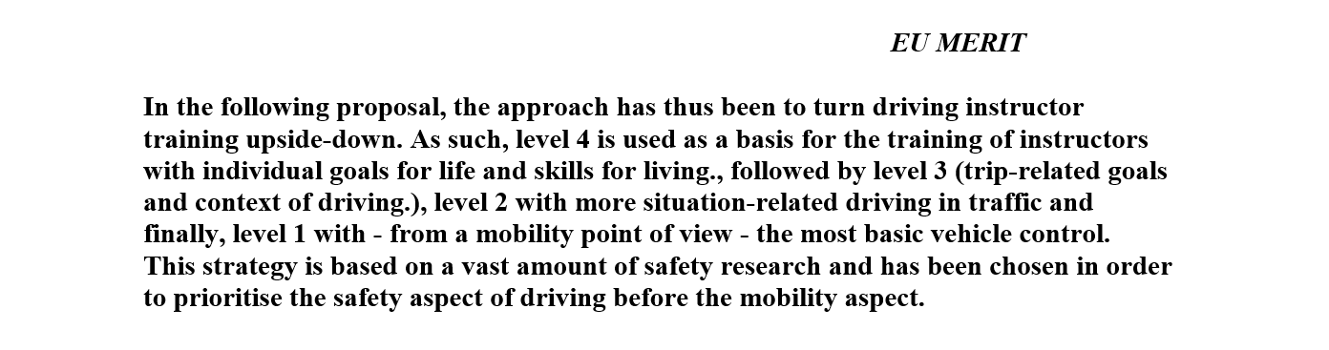
GDE Matrix
(Goals for Driver
Education) &
EU MERIT PROJECT

Slide 13
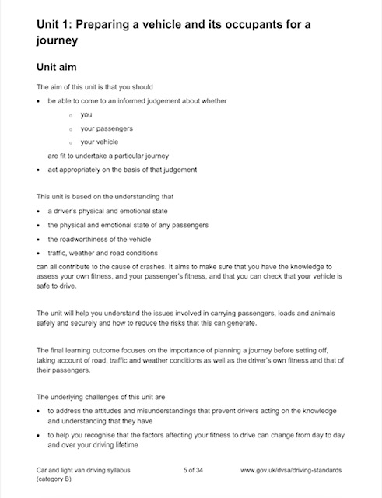
DVSA SYLLABUS
‘A TOP DOWN APPROACH’
This unit is based on the understanding that
a driver’s physical and emotional state
the physical and emotional state of any passengers
the roadworthiness of the vehicle
traffic, weather and road conditions
can all contribute to the cause of crashes
The underlying challenges of this unit are
to address the attitudes and misunderstandings that prevent drivers acting on the knowledge and understanding that they have

Slide 14
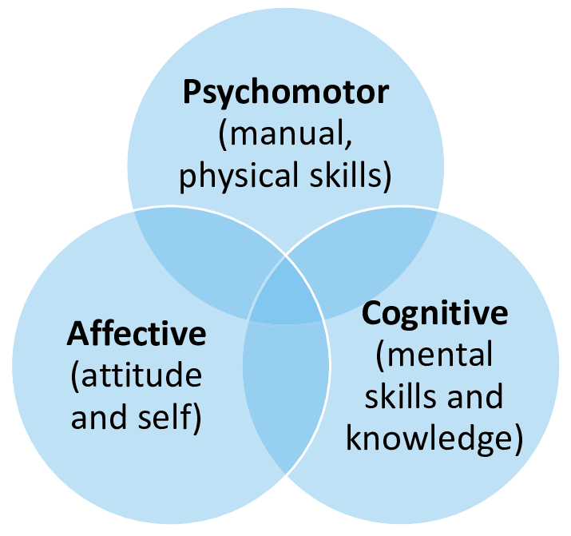
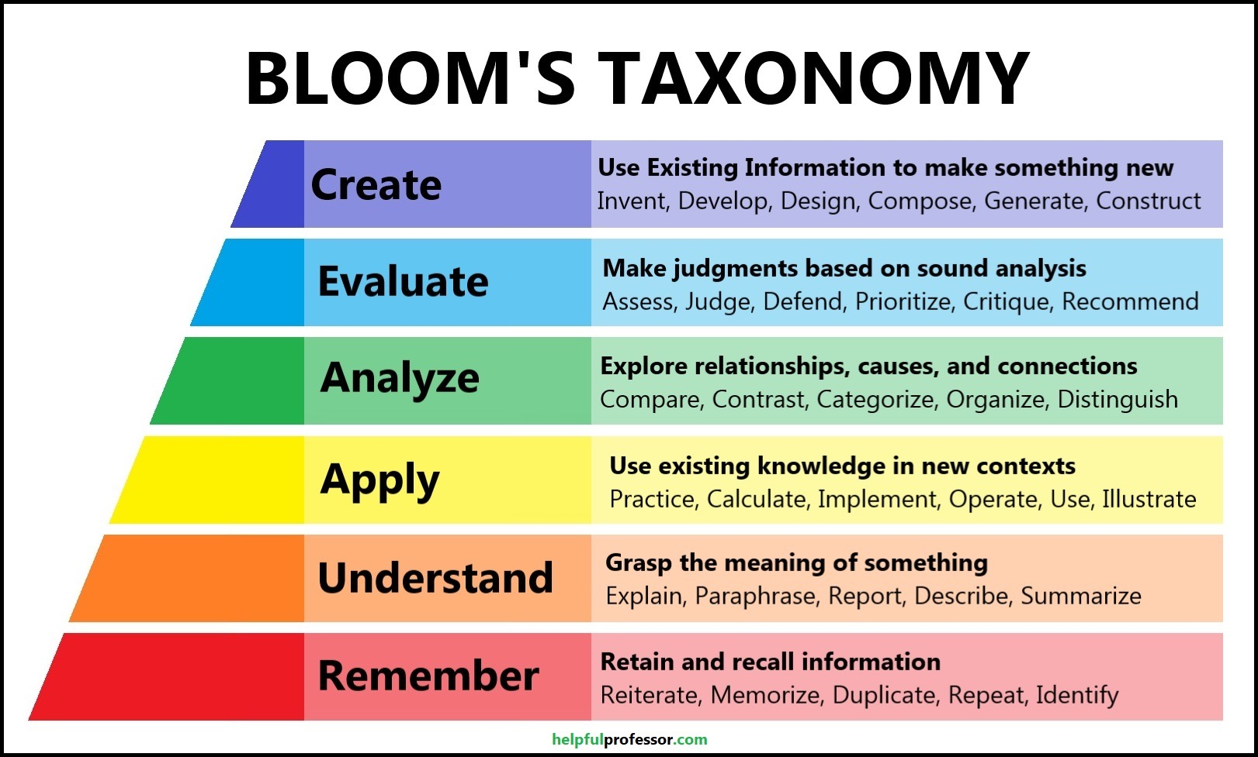
LEARNING
DOMAINS &
SPECIFIC GOALS
Identifying The Learning Goals
and Needs Of The Pupil
Did The Trainer ID The Learning
Goals and Needs of The Pupil
The cognitive learning domain involves intellect—the understanding of information and how that develops through application on a scale that increases from basic recall to complex evaluation and creation.
The psychomotor learning domain involves our physicality and how that develops from basic motor skills to intricate performance
The affective learning domain involves our emotions toward learning and how that impacts on our ability to perform from a low order process, such as listening, to a higher order process, like problem solving.
….

Slide 15
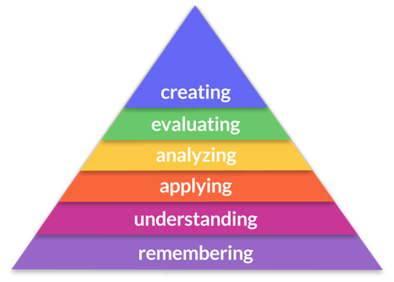

LEARNING
DOMAINS
& STALLING
Identifying The Learning Goals
and Needs Of The Pupil
CCL
“I HATE THIS JUNCTION”
Under developed skill (Psychomotor) leads to stalling at lights
Results in negative thoughts (Cognitive) towards that particular junction
Impacts negatively on emotional state (Affective) whenever the junction is approaching
Leads to increased negative behaviour (STALL) in that particular junction
Even when skill is developed, pupil more likely to stall at THAT junctions
Because all 3 domains are intrinsically linked
First Lesson

Slide 16
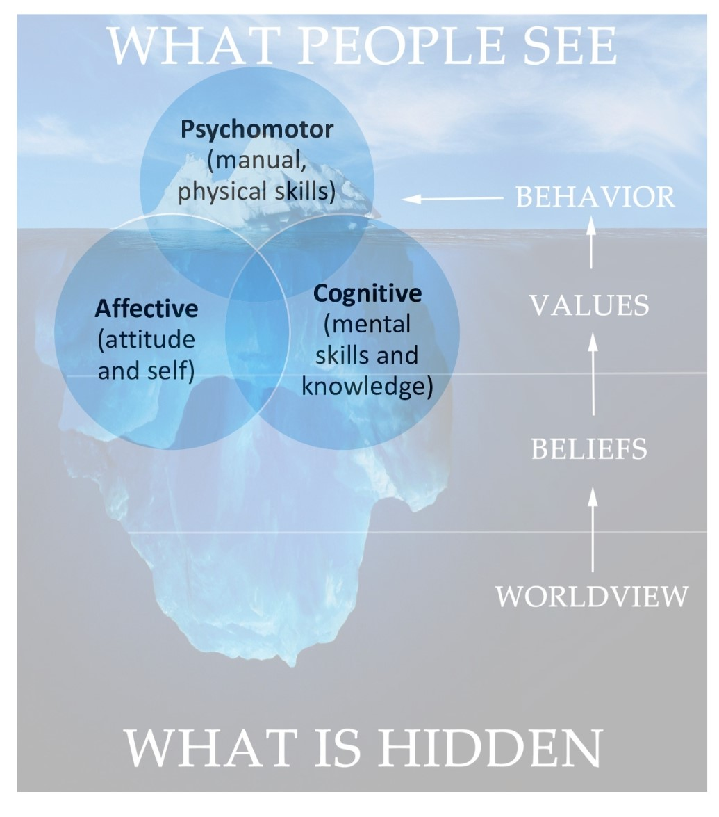
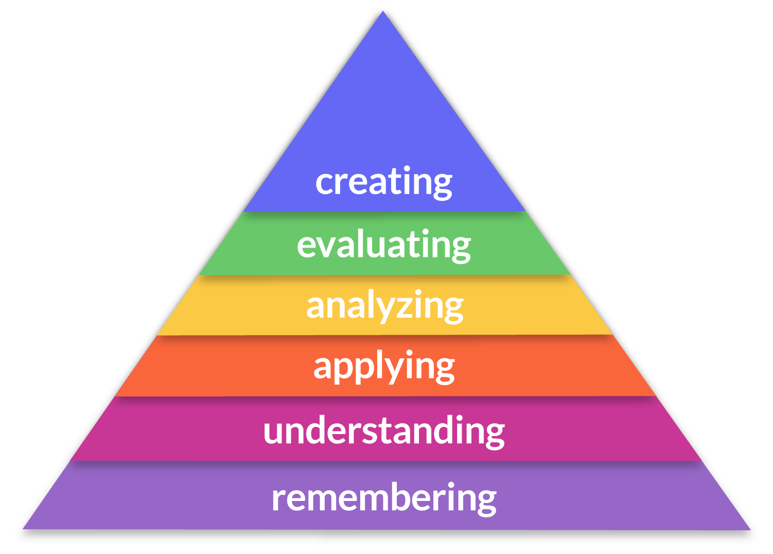
LEARNING
DOMAINS
Group Discussion
Identifying The Learning Goals
and Needs Of The Pupil
CCL
In groups imagine that your pupil has repeatedly stalled in a particular junction….Discuss :-
What might be the specific goal to help the pupil develop in the Cognitive Domain?
What might be the specific goal to help the pupil develop in the Affective Domain?
What might work in each domain in order for your pupil develop?

Slide 17
Specific Goals
(Psychomotor/Cognitive/Affective)
&
Suitable Practise Areas
Practise areas such as roundabouts are platforms around which we develop learning in 3 domains:
(Psychomotor skill, control/ Cognitive knowledge, understanding/Affective feelings, emotions)
What impact could overstretching your pupil with very complex practise areas have on their Thoughts and Feelings?
How can using short repeatable practise areas give maximum opportunities for learning?
If a pupil struggled with confidence in judging gaps at roundabouts, would you have to use roundabouts to develop that need?
If we use topics & platforms to help our pupils to understand, that their thoughts and feelings impact on what they do. Could this help to create safer-drivers?
Were The Practise Areas Suitable

Slide 18
Specific Goals
(Psychomotor/Cognitive/Affective)
&
Lesson Structure
Does anyone know what is meant by block learning / chunking ?
If we break learning down and encourage reflection in all 3 domains could this create safer drivers?
Can you pull up to discuss progress on SC ?
Direct questions to ensure that you are efficient with time on SC
Any lengthy discussions should be flagged up to come back to at end of lesson for next time
-------
Were The Practise Areas Suitable
….

Slide 19
Specific Goals
(Psychomotor/Cognitive/Affective)
&
Lesson Structure
Ensure that the structure (practise/reflection) addresses the specific goal. Discussion and focus should centre around the learning needs of the pupil.
Specific goal…improve confidence judging gaps on roundabouts
Structure of lesson should give maximum opportunities, direction taken is not relevant.
Focus should be on confidence and judgement
Let examiner see your workings – if you’ve adapted for a specific reason, ensure both the pupil and SE are aware of why
Was The Lesson Structure Suited to
The pupils Experience and Current
Ability

Slide 20
Specific Goals
(Psychomotor/Cognitive/Affective)
&
Adapting The Lesson
How does understanding that the 3 learning domains are intrinsically linked:-
Control , skill / knowledge, thoughts/ feelings, emotions help you decide when and how to adapt the lesson?
Does adapting the lesson mean you have to change the entire plan?
How can adapting the lesson to develop skills (setting off etc) help to develop the specific goal of building confidence judging gaps?
….
Was The Lesson Plan Adapted When
Appropriate To Help The Learner
Work Towards Their Goal

Slide 21
Specific Goals
(Psychomotor/Cognitive/Affective)
&
Adapting The Lesson
If you don’t ask questions around the thoughts and feelings of your pupil, how will you determine when and how to adapt the lesson?
Why is it important that your pupil understands why and how the lesson is being adapted?
Understanding that all 3 domains are intrinsically linked, each one affects the other, helps us to know how and when to adapt the lesson
Was The Lesson Plan Adapted When
Appropriate To Help The Learner
Work Towards Their Goal

Slide 22
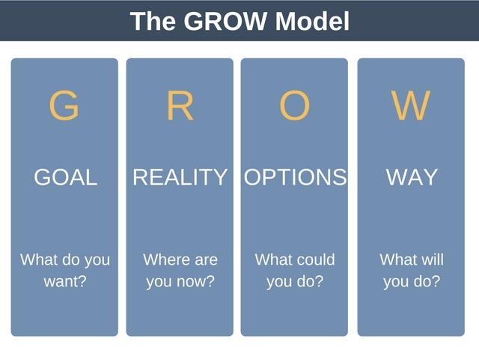
THE GROW MODEL
FOR
LESSON PLANNING
Goal – Specific (Psychomotor, Cognitive, Affective) Links to 1st competence on SC1 (Learning goals). (Evaluation)
Reality – What experience do they have? Links to 2nd competence (Structure of lesson) (Self-Evaluation)
Options – How will you develop, what platforms? Links to 3rd competence (Practice areas) (Responsibility)
Way Forward – How will this work, what help might you need ? Links to 5th competence (Dividing Responsibilities) (Responsibility)
….

Slide 23
GROW MODEL
GROUP EXERCISE
Coach to use GROW model to hold discussion with pupil at start of lesson to set up the Goal for the session and structure of the lesson.
Coachee come to the front and get your aims and objectives from us. Be nice to the coach, do not role play your most difficult pupil.
Observer observe how the coach uses GROW and where the feedback is coming from. Who is providing the input? Where are the options and way forward coming from. Was the reality discussed?

Slide 24




RGOW
FOR ADAPTING THE LESSON
Reality – What was the experience (good/bad) What were the risks ?
Goal – Based on the new reality what do you want to develop
Options – How are you going to improve this, make this safer ?
Way Forward – How are you going to develop this, Will you need help? How will this new way make it safer ?
Links to 4th competence (Lesson Planning) Adapting the lesson
Can link to 9th competence (Risk Management) Sufficient Feedback

Slide 25
RGOW MODEL
GROUP EXERCISE
Coach to use RGOW model to hold discussion with pupil part way through the lesson to ADAPT the lesson.
Pick scenario, pupil was approaching roundabouts, lesson adapted due to pupil achieving or because of safety critical intervention
Coachee can be more transparent with what happened, coach would have seen it.
Observer observe how the coach uses RGOW and where the feedback is coming from. Who is providing the input? Where are the options and way forward coming from. Was the REALITY discussed first?

Slide 26
SC & Part 3
Pass Marks
&
Risk Management
Grade A – 51 to 43
Grade B – 42 to 31
Fail – 30 or below
Failure on Risk Management – 7 or below

Slide 27
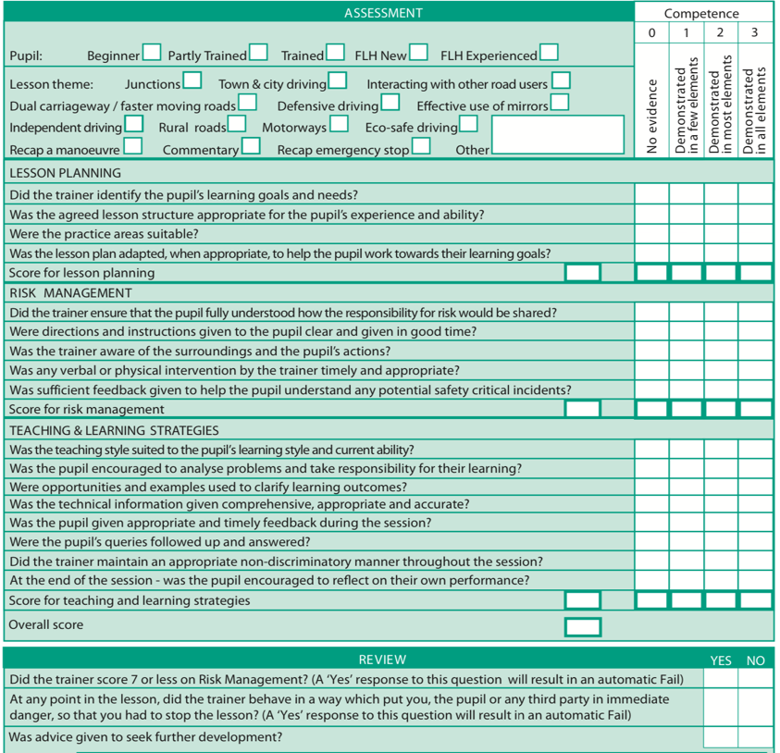

THE SC 1 REPORT & HOW
THE COMPETENCIES
INTERLINK
FOR OFFICE USE ONLY !!!

Slide 28
Risk Management
5 Competencies
Dividing Responsibilities
Did the trainer ensure that the pupil fully understood how the responsibility for risk would be shared
This is not a speech about dual controls
Breaking down tasks accelerates learning
CCL not CLL (Client Led) – I want to go on the motorway!
Manage Risk inside of Goal and outside of Goal

Slide 29
Risk Management
5 Competencies
Directions &
Instructions
Were directions and instructions given clear and in good time?
How do clear and timely directions and instructions manage risk?
What constitutes directions and instructions?
Clear directions – First/Second road on left not ‘Next’
Timely Instructions – What type of questions could manage risk on the move?
Why do leading Q’s remove the need for sufficient feedback (5th competence in Risk management)

Slide 30
Risk Management
5 Competencies
Surrounding Areas
& Core Comps
Was the trainer aware of the surrounding areas and pupils actions?
Fault Id / Fault analysis / Fault remedy
Where do the Core comps fit in here?
How do you know what to observe and when?
Routines (MSMPSL etc) / Hazard planning / Comms driving / Conscious competence in own driving
Leads into Leading Questions
Your ability to do this helps to keep the pupil responsible

Slide 31
Risk Management
SUMMARY
Group Exercise
(5 mins)
In groups discuss the following scenario:-
Pupil (part trained), Goal is to improve confidence approaching roundabouts and judging gaps
Discuss how you might divide responsibilities (Inside the goal for progress) & how dividing responsibilities in this way will help the pupil to achieve the goal
What risks could need managing outside of the goal (e.g meeting, clearance etc)
How would you manage risk on the move – inside the goal / outside goal

Slide 32
TOP 5 REASONS ADI’S FAIL STANDARDS CHECKS
DVSA analysis shows the top 5 areas where instructors fail to demonstrate competence are where they haven’t:-
Adapted the lesson plan, when appropriate, to help the pupil work towards their learning goals
Taught the lesson in a style suited to the pupil’s learning style and current ability
Encouraged the pupil to analyse problems and take responsibility for their learning
Given the pupil appropriate and timely feedback during the session
Given enough feedback to help the pupil understand any potentially safety-critical incidents

Slide 33
Risk Management
Sufficient Feedback
Was sufficient feedback given to help the pupil understand any potential safety critical incidents
What happened ? (Fault ID)
Why did it happen ? (Fault Analysis) (Psychomotor/cognitive/affective)
What are the risks involved ?
How could you improve it / make it safe ? (Remedy)
What are the benefits of the new approach ?
….

Slide 34
Risk Management
Sufficient Feedback
Was sufficient feedback given to help the pupil understand any potential safety critical incidents
Learning around risk v underdeveloped understanding of risk
Fault analysis and remedy – from where?
NSDRT – Unit 6.4.1 Manage the on-road environment to minimise risk “correctly understanding the nature of the risks that arise is central to the learners ability to assess and respond to risk when they drive independently”

Slide 35
THE RGOW MODEL
FOR Sufficient Feedback
Reality – What happened ? Why ? What are the risks
Goal – Leads to new goal to develop area of risk and adapting the lesson
Options – How are you going to improve this, make this safer
Way Forward – dividing responsibilities, consider benefits of new plan in comparison to the risk of the old behaviour

Slide 36
Leading Questions
To
Manage Risk
WHAT will YOU DO about….
HOW are YOU GOING to….
WHEN will YOU (SLOW/BRAKE/STEER) for…
WHY should YOU (SLOW DOWN/STEER AWAY) for/from…
(…INSERT HAZARD) the Cyclist, Pedestrian, Parked cars

Slide 37
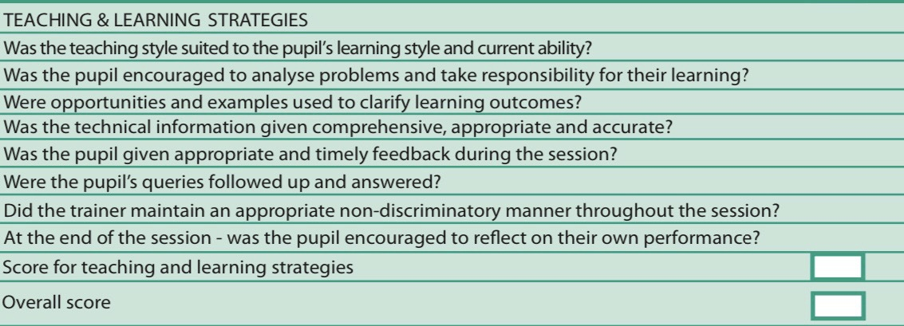
Teaching & Learning Strategies

Slide 38
Teaching & Learning Strategies
Client Centred
Learning
& 3 T&L
Competencies
Was the teaching style suited to the pupils learning style and current ability
(CCL) because it is the Instructor adapting to pupil vs pupil adapting to instructor
Was the pupil encouraged to analyse problems and take responsibility for their learning
(CCL) because the Core comps (analysis & remedy) are elicited from pupil
Were opportunities and examples used to clarify learning outcomes
(CCL) because it gives context and uses already developed skills to develop around new goal. Accelerates learning. It is a goal focus v fault focus

Slide 39
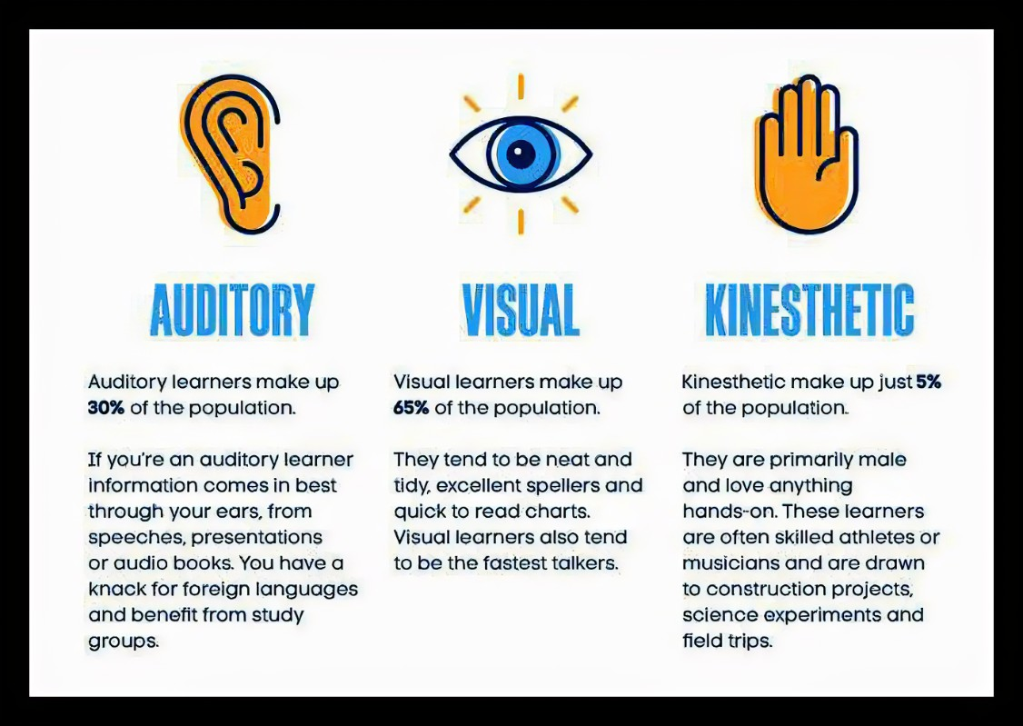
Teaching & Learning Strategies
Client Centred
Learning
&
VAK
Was the teaching style suited to the pupils
learning style and current ability

Slide 40
Teaching & Learning Strategies
SMOOTH
Scale
Scale – (0-10) Define the scale (0 terrible / 10 great)
Measure – All the good things that impacted the scale
Opportunities – To develop
(These elements develop evaluation and self-evaluation skills)
Options – To go forward, where on the scale would you like to get to?
Time – Management – How long before reflection
Help – If any ?
(These elements help to develop responsibility in pupils)
Was the pupil encouraged to analyse problems and take responsibility for their learning?

Slide 41
Teaching & Learning Strategies
Opportunities
&
Examples to clarify learning outcomes
Were opportunities and examples used
to clarify learning outcomes?
What is the purpose of this competence?
How does this accelerate learning ?
What previous learning could be used to help a pupil to develop approach speed to roundabout’s
What skills would they already have?
How does this competence also link to learning style & CURRENT ABILITY (1st competence under T&L strats) ?
MSM routines for example could be transferred from existing knowledge to new topic and remove the need for briefing
Context from existing knowledge, transferred to new learning. (Adult learning)
….

Slide 42

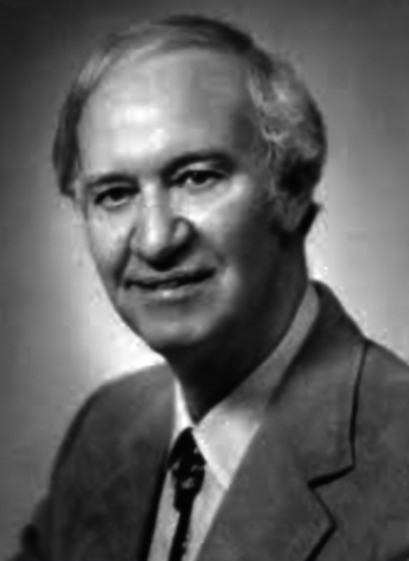
Teaching & Learning Strategies
Andragogy
(Adult Learning)
& How we address the principles with CCL
Some recognised & accepted principles of adult learning (Malcolm Knowles theory of andragogy 1968 / 1989) :-
Autonomy – Adults prefer a sense of control & self-direction (Options & Way Forward)
Goal-Orientated – Adults prefer learning that helps them reach their (Goal)
Practical – Adults need personal relevance in activities (G.D.E. level 4)
Wealth of Knowledge – Adults have accumulated a unique store of knowledge that they bring to the situation (Reality – Prior learning)
Big Picture – Adults need a big picture view and to know how the smaller parts fit in to the bigger picture (Goal focus, Post-Test and context)
18yrs – 29yrs

Slide 43
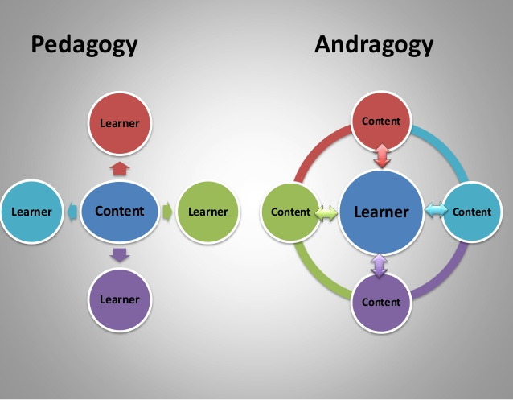
Andragogy
(Adult Learning) vs
Pedagogy
(Child Learning)
Client Centred Learning vs
Instruction?
18yrs – 29yrs
WHY WE MUST ADAPT TO CCL
Instruction vs CCL ?

Slide 44
Standards Check
Workshop
Lee Jowett
07795279916
Lee@adikit.co.uk
Mick Knowles
07790456012
Mick@adikit.co.uk
Thank You For Your Attendance

Slide 45
Teaching & Learning Strategies
HOMEWORK
VAK – Take 15 minutes to plan how many ways can you adapt your teaching style to the pupils learning styles
What opportunities and examples might you find to clarify learning outcomes :- Before car moves (previous experience) On the move (pre-developed skills) (Similar thought processes) (Understanding of emotions)
What difference will this make to learning?
How will this help you on your SC/Part 3?
How could this create safer drivers post-test?
PUT THIS INTO PRACTISE ON THREE LESSONS THIS WEEK.

Slide 46
Teaching & Learning Strategies
Scaling - SMOOTH
HOMEWORK
Pick a pupil you think will be helpful and use scaling at various points through the lesson to develop evaluation skills
Reflect on how this teaching strategy helps to encourage the pupil to analyse problems and take responsibility for their learning?
Plan how you will use this effectively on the move? (The ‘S’ can be very useful)
How can you use this on SC or part3 efficiently at side of road – given current SOP’s (targeted and direct Q’s)
What difference will this make to learning?
How could this create safer drivers post-test?
How will this help YOU on your SC / Part 3?

