Slide 1
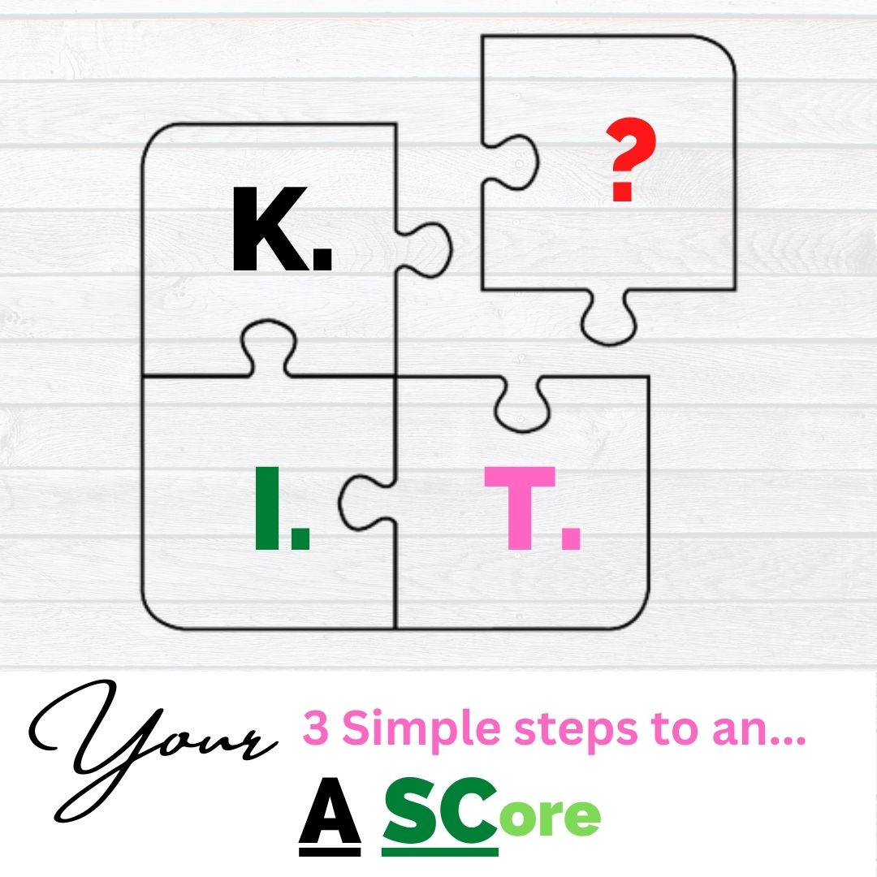


3 Simple Steps to an
A SC ore
WORKSHOP

Slide 2
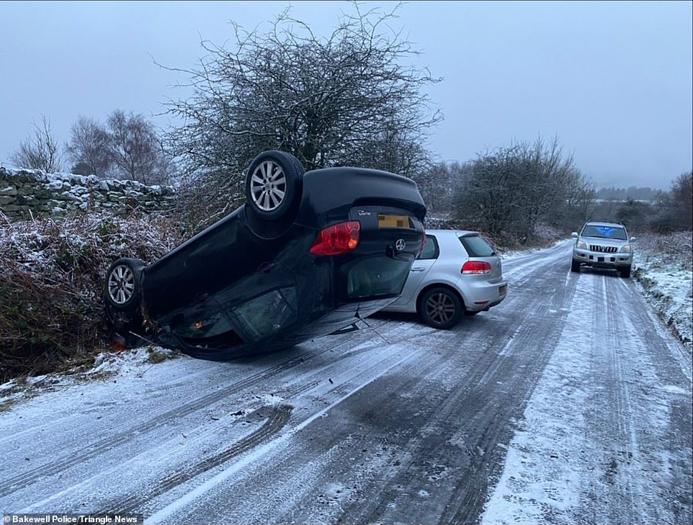


3 Simple Steps…
KEEP THE CAR SAFE
Be Aware Of Your Surroundings and Your Pupils Actions
Be aware of what your own actions would be in the situation
1st Response observe pupil acting accordingly
2nd Response, where possible, ask LEADING QUESTIONS to raise awareness of risk:-
What is your plan for…. Why should you… When will you…. How are you going to…?
…..

Slide 3
3 Simple Steps…
KEEP THE CAR SAFE
3rd Response, where possible, ask Direct Command Questions to illicit response:-
How will you SLOW DOWN…. When will you BRAKE…. Do you think you should STEER away?
4th Response, where possible, INSTRUCT !!
LAST RESORT…..Verbal or Physical Intervention
Then….Sufficient Feedback required:-
What happened (Fault ID), Why (Fault Analysis)
How will you improve it (Fault Remedy), Potential consequences (BC) v Benefits (BC)
Last Resort may need to be FIRST RESPONSE

Slide 4

3 Simple Steps…
IDENTIFY LEARNING GOALS AND NEEDS
Runs through entire session
Carries forward from observing surroundings and pupils actions
If pupil misses something, raise it, question it
If pupil repeatedly misses something (accumulation of Driver faults), adapt lesson to include the NEED into the GOAL
If pupil gets something badly wrong (Serious or Dangerous fault) then… Sufficient Feedback and ADAPT the lesson
Consider the INITIAL GOAL will last approx. 10-15 mins

Slide 5

3 Simple Steps…
TEACH AROUND GOAL AND RISK
By keeping the car safe and being proactive we MANAGE RISK so that the pupil can continue to focus on GOAL of lesson
Breaking down the task around GOAL and RISK and sharing responsibility helps learning to take place in a safe environment
IF pupil takes responsibility for RISK on the move and keeps the car safe or is achieving the GOAL….Ensure that learning takes place !! What was good ? How did they make the decision? Benefits? Did they have other options? WHAT IF!!
IF pupil gets something ‘WRONG’ around GOAL or RISK ensure that learning takes place What didn’t go so well ? What led you to make that decision? What are the potential CONSEQUENCES? Did they have other options? WHAT IF!!

Slide 6
Thank You for attending
FIND MORE OF OUR COURSES AT:-
WWW.ADIKIT.CO.UK/COURSES
Lee@Adikit.co.uk Mick@adikit.co.uk

